Slide 1
COMPASS POINTS Understanding Preferences
in Group Work
Notes:
1

Slide 2
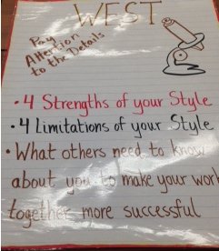

Slide 3
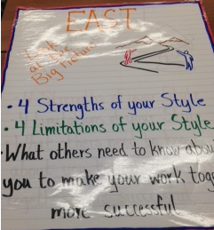

Slide 4
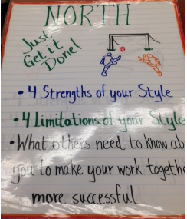

Slide 5
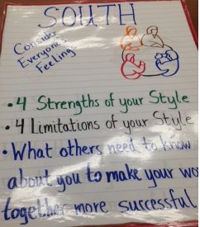

Slide 6
COMPASS POINTS
NORTH – Just Get It Done
Like to act, try things out, plunge in
SOUTH – Consider Everyone’s Feelings
Like to hear & honor all voices before acting
EAST – Look at the Big Picture
Like to speculate, consider possibilities before acting
WEST – Pay attention to the details
Like to know who, what , where, why before acting

Slide 7
COMPASS POINTS
As a group, discuss the following:
4 ASSETS of your style you bring to a team
4 LIABILITIES/LIMITATION of your style you bring to a team
What do your teammates need to know about your group’s style to make your work together more successful?

Slide 8
True Colors Personality Assessment
Logical, Competent, Accurate, Concise, Persistent, Careful, Intellectual, Impartial Inquisitive, Logical, Innovative, Detached Systematic, Focused
Action-oriented, Quick-witted, Charming, Bold, Spontaneous, Dynamic, Energetic, Problem-solver, Risk-taker, Creative, Multi-tasker
NORTH
SOUTH
EAST
WEST
Faithful, Dependable, Efficient, Practical, Systematic, Orderly, Thorough, Sensible, Proper, Organized, Punctual, Helpful, Stable, Traditional
Sensitive, Sincere, Appreciative, Expressive, Caretaker, Inspirational, Flexible, Creative, Inclusive, Mediator, Idealistic, Intuitive, Loyal, Collaborative

