Slide 1
Phase 1 of Project Design
Consider Your Context
Which students or class will be involved?
When will I implement the project?
What concepts, topics, and standards will be included?
What type of project is best for my students, my content area, and me?
How long will my project be?
How many subject areas will be included?
Who will be involved?
Notes:
1

Slide 2
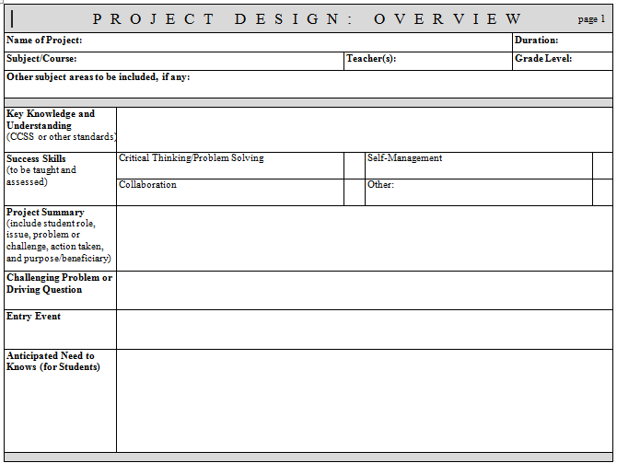
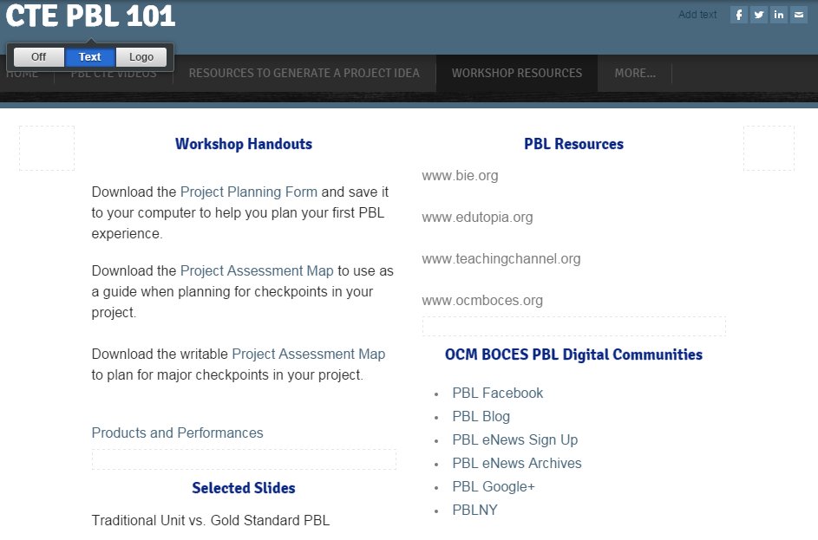
Project Design: Overview
Determine Context
Notes:
2

Slide 3
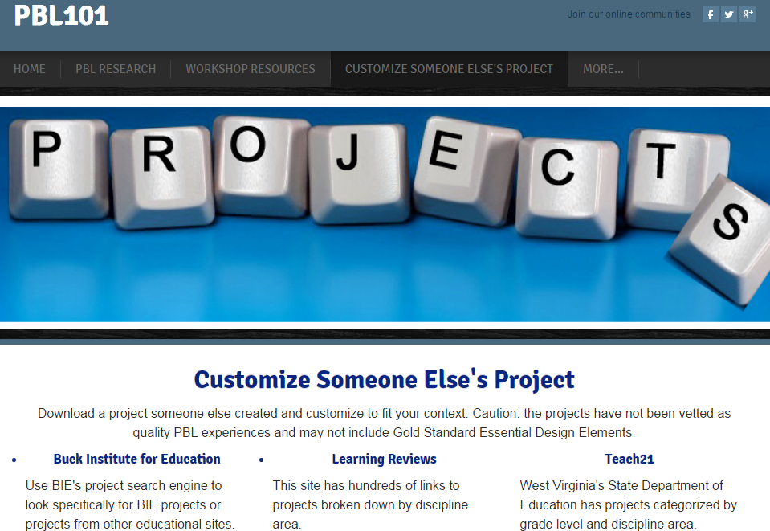
Phase 2 of Project Design
Generate a Project Idea
Customize Someone Else’s Project
Does it address the standards/content I need to target?
Is the project worthy of instructional time?
Will my students be engaged?
Is the length and level of complexity appropriate for my students?
Notes:
3

Slide 4
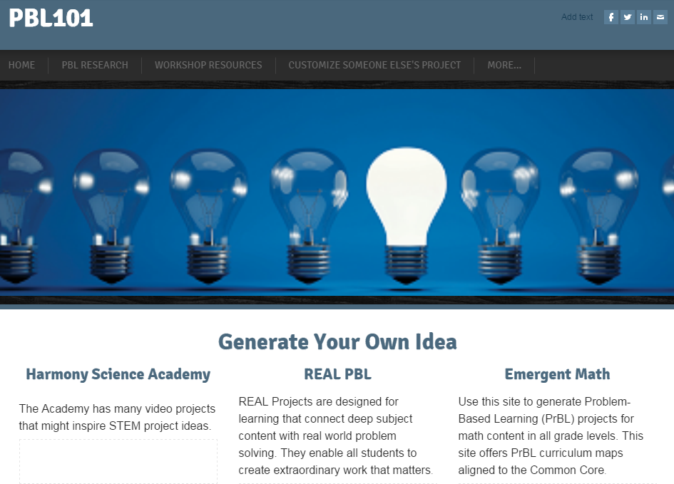
Generate a Project Idea
Generate Your Own Idea
Issues in your school or community
Current events
Real-world problems
Content standards
Students’ lives and interests
Click “MORE”
Notes:
4

Slide 5
Phase 3 of Project Design
Build the Framework
Set learning goals
Select major products/performances
Decide how products/performances will be made public
Write a driving question
Notes:
5

